Slide 1
Tech Summit '26 · Te Pae, Christchurch · 16 September 2026
Cybersecurity in the
Age of AI
Safeguards and tactics to offset risks when AI fails
Charles Herring Chairman and co-Founder, WitFoo
charlesherring.com
Notes:
Good afternoon. We're going to cover three topics today.

Slide 2
THE NEXT THIRTY MINUTES
1
2
3
How the new
machines work
How criminals
are using them
What we do
and what they cost
three impacts, no answers yet
the controls, the evidence, the neighbourhood
Notes:
We're going to first look at what's changed in the machines and what we're calling artificial intelligence. Then we're going to move on to how the criminals are using these new approaches. And then at the tail end of this talk, we'll look at what do we do in this new world where things have changed.

Slide 3
charlesherring.com
These slides, and a blog entry with the whole argument.
You don't need to take notes.
Notes:
This presentation deck, a recording that I made for practice, my LinkedIn profile, which I hope you'll use to connect so we can continue this conversation, and a blog about this topic is all up on my website at charlesherring.com. You don't need to take any notes. You can download everything that I'm showing you here today.

Slide 4

One question.
Watch how you answer it.
Notes:
So let's start with a question and a little bit of a thought experiment, and I want you to pay attention to how your brain answers this question. All right, ready?

Slide 5
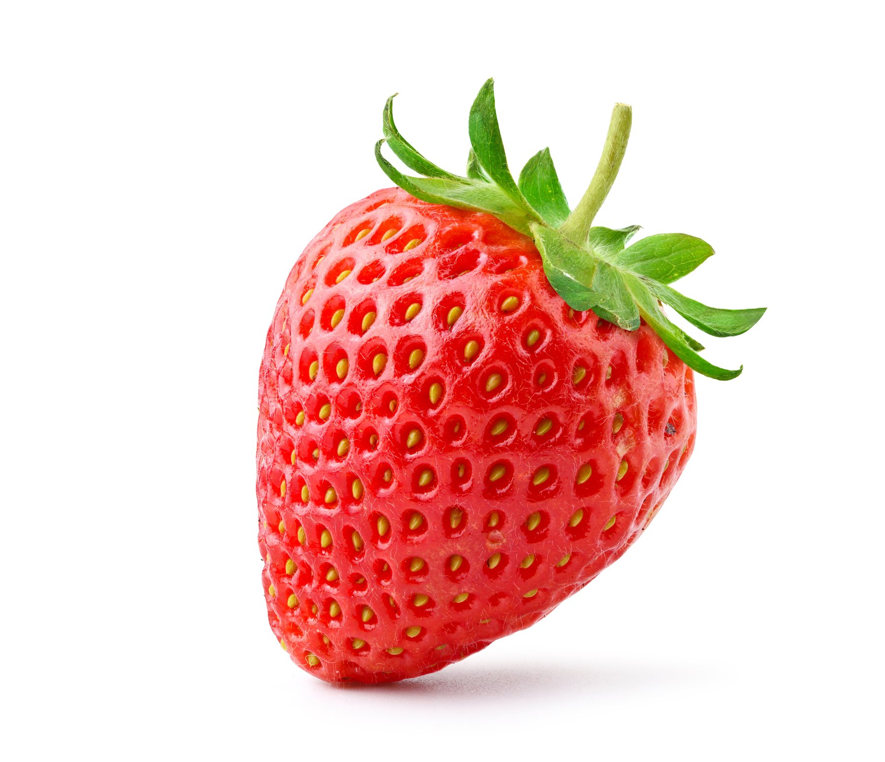
How many R's?
Raise your hand when you have it.
Notes:
Here we go. How many Rs are in the word strawberry? When you have it, raise your hand just so I can see. Okay, good.

Slide 6
s t r a w b e r r y
1 Retrieve the spelling
2 Break it into letters
3 Count the R's
Deterministic. Same input, same answer, every time. And you can show your work.
Notes:
So I think most of us got three as the number of letter-- number of Rs that are in strawberry in the room. The way that we did it, we remembered how to spell strawberry. We broke it into its letters. We counted how many of those letters are Rs. And that process is an example of deterministic processing. Same process every time, same answer every time. It's reliable, it's defensible, and it's predictable.

Slide 7
COMPUTERS HAVE DONE THIS FOR FIFTY YEARS
Written by humans.
Does what it was told.
Every time.
Forever.
And for free.
word = "strawberry"
print(word.count("r"))
3
We have benefited from this in millions of ways over five decades.
Notes:
Computers have been very good at doing this for the last fifty years. We use it for everything. On the left side of the screen, we see there's two lines of code to calculate how many Rs are in strawberry. Very fast, very inexpensive, accurate, defensible, and code written by human beings. Deterministic code has been doing everything in our lives for the last fifty years.

Slide 8
It streams your content.
Notes:
It streams the content to our phones or our television sets.

Slide 9
It runs your phone.
Notes:
It runs all the applications on our telephones.

Slide 10
It powers our games.
Notes:
It powers our video games.

Slide 11
It checks the accounting.
Notes:
It handles our accounting and our spreadsheets and our online accounting software.

Slide 12
It runs the internet.
Notes:
It runs everything on the Internet,

Slide 13
It sends your feedback
through the event app.
Deterministic code, written by humans, at speed and at almost no cost.
Notes:
And it allows you to send feedback through the app about this session, which I do encourage you to do.

Slide 14
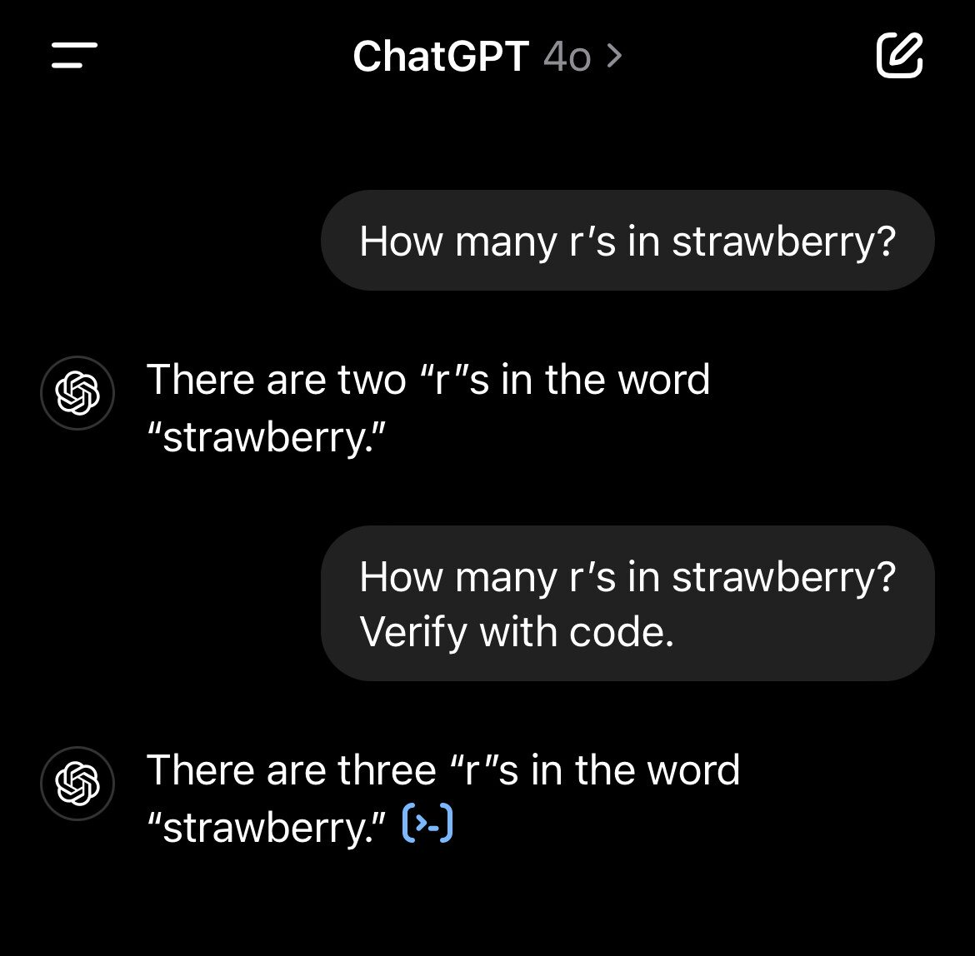
A LANGUAGE MODEL ON ITS OWN
Probabilistic.
Trained, not coded.
Nobody ever wrote the letter counts down. Nothing to retrieve. No way to count.
So it does the only thing it can do.
It guesses.
Notes:
As you can see here in this chat on the left, ChatGPT struggled with how many Rs are in strawberry. And by the way, as of yesterday, ChatGPT's Astra 6 still struggles with how many Es are in seventeen, so this is a, an ongoing problem with probabilistic models. It cannot guess how many Rs are in strawberry any more than we could guess. We have to count, but these models are built to guess.

Slide 15
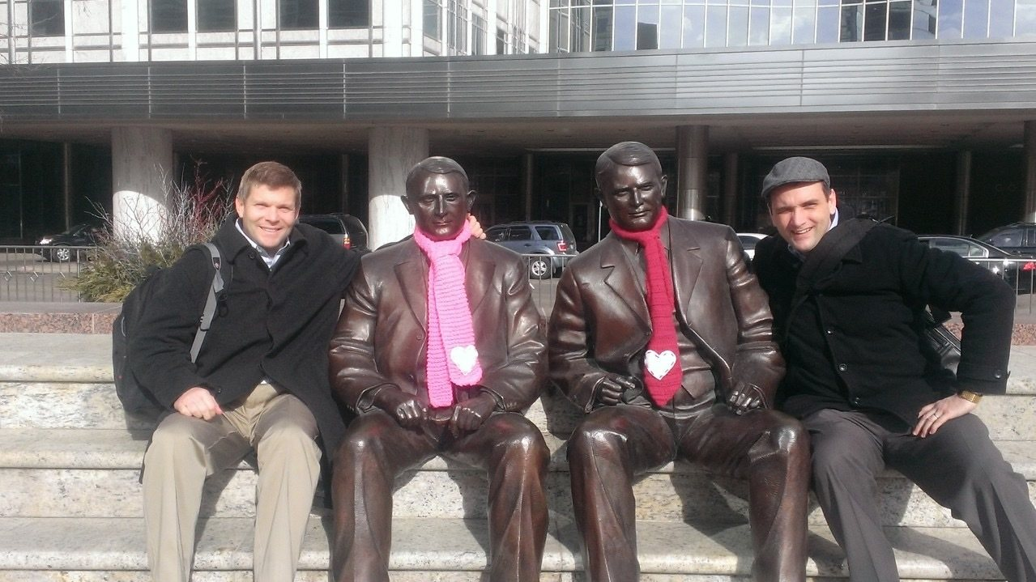
How a human
guesses well.
Charles and Tim, 2012
Notes:
Here on the left side is my co-founder, Tim Bradford. On the right is a younger version of me right when we first met as a sales team. He was the seller, I was the engineer. And in one of our first sales meetings, he ran the whole thing because I didn't know what to do, and my role was just to answer any questions that he couldn't. And so I s-- I paid attention to what he was doing. Meeting was going very well, and at the end of the meeting, one of the customers asked a very complicated question about wide area network and MPLS encapsulation. And I thought, "Hey, here's my moment. I'm going to shine. I'm going to show Tim and everybody else how smart I am." So I waited for Tim to look over at me to, to pass the question over, but he didn't. Instead, he opened his mouth, gave an answer that was better than what I would have given, and I was just dumbfounded and crestfallen. Later on, I asked him "Tim, how do you know so much about wide area networks?" And he said, "Charles, I have no idea what MPLS is.

Slide 16
“Charles, I have no idea what MPLS is. All I know is that when I get asked that question, that's the answer that works.”
Probabilistic processing, by a human.
Tim's trick is what generative AI added, at scale.
Notes:
All I know is when I get asked that question, that's the answer that works." And so this is a good example of how probabilistic processing works in our minds, and that Tim had more than ten years of experience in these meetings, being asked questions, hearing the answers, so he could guess what the right answer was, even though he has no idea what MPLS or wide area networking is.

Slide 17
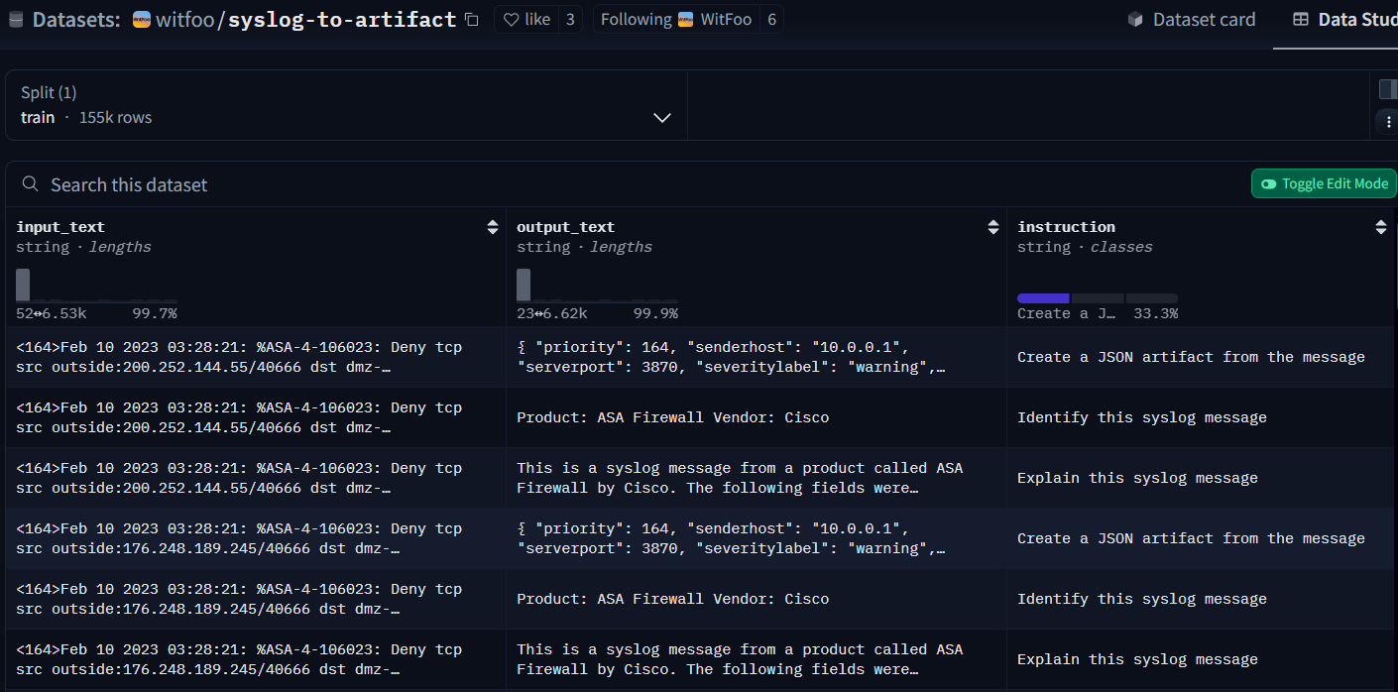
HOW A MODEL LEARNS
input
+ instruction
+ the answer
we expect
155,000 rows.
It learns the answer that works.
It never learns what a firewall is.
huggingface.co/witfoo · open source
Notes:
This is one of our open source datasets. On the left is an example of a firewall message coming from a firewall. On the right is an instruction that says, "Identify this message." And in the middle is what we expect the model to respond with, product, ASA firewall, vendor, Cisco.

Slide 18
THE PIVOT
Probabilistic
generation
writes
deterministic
code
which gives a
provable
answer
The guesser has learned to reach for the counting machine.
Notes:
And so what we do is we train these models on these datasets, and they pick up patterns the same way that Tim picked up patterns on what a good answer is to a given question. Now, in, in the continuation of that chat we saw earlier with ChatGPT the user asked, "Verify with code," which is probably one of the most important things to realize about the innovations is that not only can they guess against datasets, one of the big datasets we've given these models is a problem as the question and code as the answer. We just have the entire Internet and open source repositories and a lot of places to train these models on how to write code, and they are very good at writing code. So in the same way that we saw there were two lines of code to generate how many Rs in strawberry, we can have the model generate that code, execute it because it is good at that. Make-- Using a probabilistic process to create deterministic code, execute it, and get a deterministic answer as it did in this example. So there's three tricks that AI can do or computers can do in what we're currently calling AI.

Slide 19
WHAT YOU ARE ACTUALLY USING: A HARNESS
THE HARNESS DECIDES
Guess: a probabilistic answer
Write and run deterministic code (skills, tools)
Your task
Deliverable
Retrieve stored facts first (RAG)
Explain a deterministic result to a human
One request. Four very different kinds of work.
Notes:
It can fetch information It can do a determinant, run deterministic code skills sometimes inside of these harnesses, and it can make a probabilistic guess. And what we're seeing now with AI harnesses that we use in our apps is when we give it a prompt, it's using a probabilistic question first. What steps should I use to execute this to answer this question? Should I use a probabilistic answer? Should I use a skill or deterministic code? Should I go and retrieve more information and then merge that together? So all of that together makes an AI harness look much smarter than just an LLM that can't guess how many Rs are in strawberry. And so because of that, it's spinning very fast, doing three of the things that humans do but ten- typically slower. Retrieve information and the rest. Retrieve information, make a probabilistic guess, or make a deterministic answer.

Slide 20
One more question.
Same rules.
Notes:
So one more minor mental experiment.

Slide 21
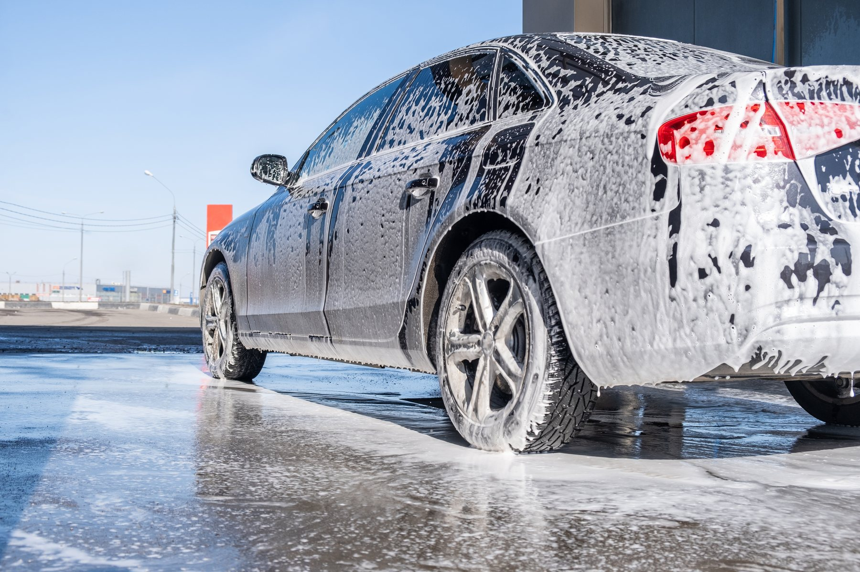
The car wash is
100 metres away.
Drive, or walk?
Answer it, and watch what your brain does.
Notes:
So again, pay attention to what your brain does in answering this question, and raise your hand once you have the you've come up with the answer. The car wash is a hundred metres away. Do I drive the car to the car wash or do I walk? All right, good. Now this is another one that ChatGPT doesn't get. You know, it's, it came up with walk. How many of us came up with walk? Okay, how many of us came up with drive the car to the car wash? How many of us said, "I'm not going to waste any money on the car wash"? All right.

Slide 22
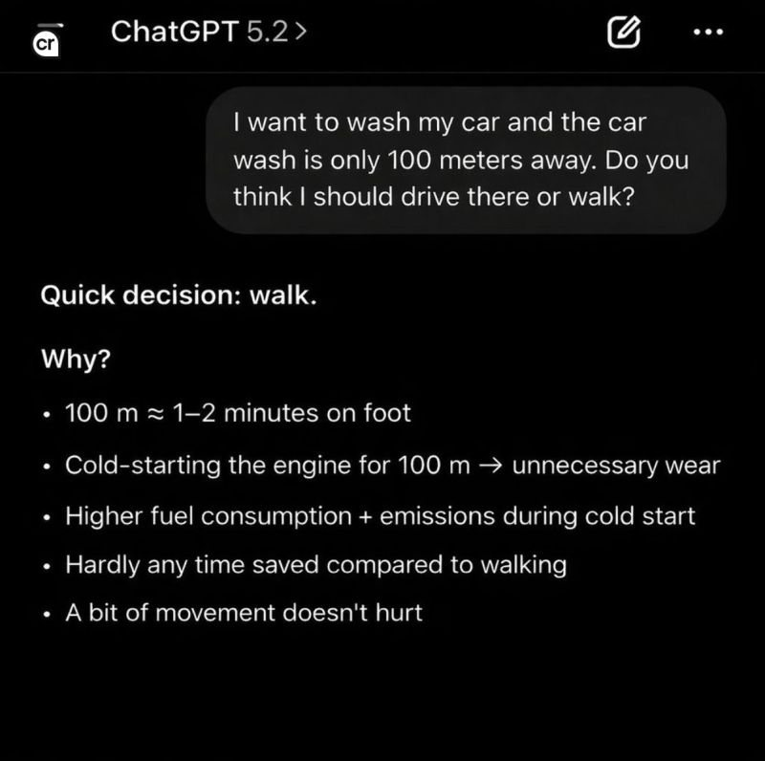
A LANGUAGE MODEL ON ITS OWN, AGAIN
It says: walk.
Can't guess it. Can't compute it. Can't recall it.
You didn't either.
You imagined it.
You built a model of the world in your head, and ran it.
Notes:
So what we did as human beings is we imagined a car, each one of us probably imagined a different car. We thought through the process of walking into a car wash without the car and how silly we would look trying to get a car wash that we didn't bring. And what that, what that is, is us building a reality. We imagined a world that had people in it, had a car wash in it, had a car. We created all of that out of nothing in our brains, created this simulation, and through that we're able to figure out we can't wash a car that we don't bring to the car wash.

Slide 23
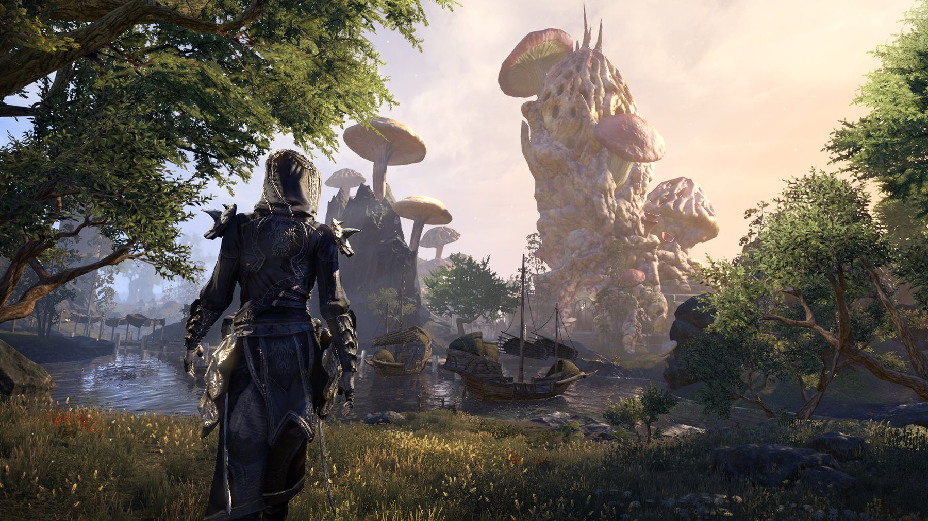
SIMULATION
A system of systems.
Game worlds. Weather forecasts. The formation of the universe.
You did a tiny version with the car wash.
Possible. At a price.
Notes:
And computers can do this. I mean, this morning I played Elder Scrolls Online this for about an hour. I was able to craft some things, sell some things, kill some things, get some skills, walk around harvest some different items from the world. We build these systems of systems, but they're not two lines of code as in find how many Rs are in strawberry. They are millions of lines of code that run on hundreds of computers. We also do this for modeling of weather forecast. Scientists of can predict the formation of the universe using these types of models.

Slide 24
THREE PRICE TAGS
Cheap
Expensive
Prohibitive
Store it, retrieve it, run deterministic code. Fifty years of getting cheaper.
Probabilistic processing. ~1,100 TWh of data centre power in 2026 (IEA). ~40% of AI data centres power-restricted by 2027 (Gartner).
Simulating the world to decide whether to walk to the car wash. Out of reach for most harnesses today.
Keep those three price tags in mind. The criminals already have.
International Energy Agency (2026 projection) · Gartner (2027 forecast)
Notes:
Computers can do it. They're just very expensive, and they're very complicated and nuanced. We can train a model on a data set, but we cannot create these system of systems without being very specific in how we code them, and we just don't have them yet, and they're quite expensive. Which takes me to a, a really critical point. Deterministic process is, is cheap, it's fast, it's defensible, and it's getting cheaper, and it has been getting cheaper for the last fifty years. Generative AI is expensive, very expensive. The International Energy Agency forecasts that we'll be burning eleven hundred terawatt-hours by the end of this year. And in perspective, the entire nation of New Zealand burns forty terawatt-hours per year. The United States burns four thousand terawatt-hours per year, so we're talking about a fourth of what Americans burn. So Gartner's forecasting by the end of next year we're going to have a deficiency, a forty percent deficiency of supply versus demand in AI. So this is something that is going to get more expensive. It's already horribly expensive and is getting more expensive. And we just don't have a great way of building simulations in computer science as we can in our minds, in the example with the car wash.

Slide 25
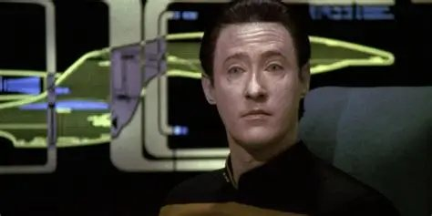
WHAT IS MISSING
The ship's computer.
Not LCDR Data.
Four things no model has, and no current innovation supplies.
Notes:
For my Star Trek fans in the r- room what we've built is very close to what's the computer on the Enterprise in the Next Generation, but it's not Lieutenant Commander Data. And so where the computer can fetch things, interact with other systems, make calculations, build databases just by us talking to it, that arguably exists, but I want to point out why we're not at this positronic matrix of Lieutenant Commander Data.

Slide 26

MISSING, ONE
Ambition,
drive and vision
No model has ever wanted anything. Leave it alone and it slips back into oblivion.
Notes:
Probably most important is it has no ambition, vision, or drive. We are all here today because we're trying to make our organisations, our families, our communities better. We have an idea of how we can do that, and we're driven by it. None of us received a request from an artificial intelligence asking for a ticket to this thing, right? We wake up as humans, and we are driving to make the world better. AI will stop working if we don't force it to keep working.

Slide 27
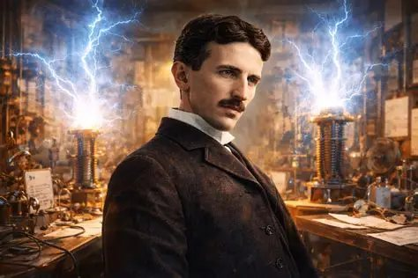
MISSING, TWO
Ingenuity
The light bulb, when the world had only candles.
Notes:
Second is ingenuity. We come up... We can not only imagine the car wash, we can imagine things that don't yet exist. We're able to create things like the light bulb or the printing press. The millions and millions of inventions that was just someone pondering a different existence than what we have. Our generative, generative AI, all that it can do is form derivatives. I can tell it re-film Sir Peter Jackson's Lord of the Rings trilogy using cats instead of humans, and if I give it enough resources and spend enough money doing it, I can do that, but it's a derivative. And even the spark of ingenuity of making Aragorn into a tabby cat, that's from me, not from the machine. There's just no ingenuity in these things. They're all derivatives.

Slide 28
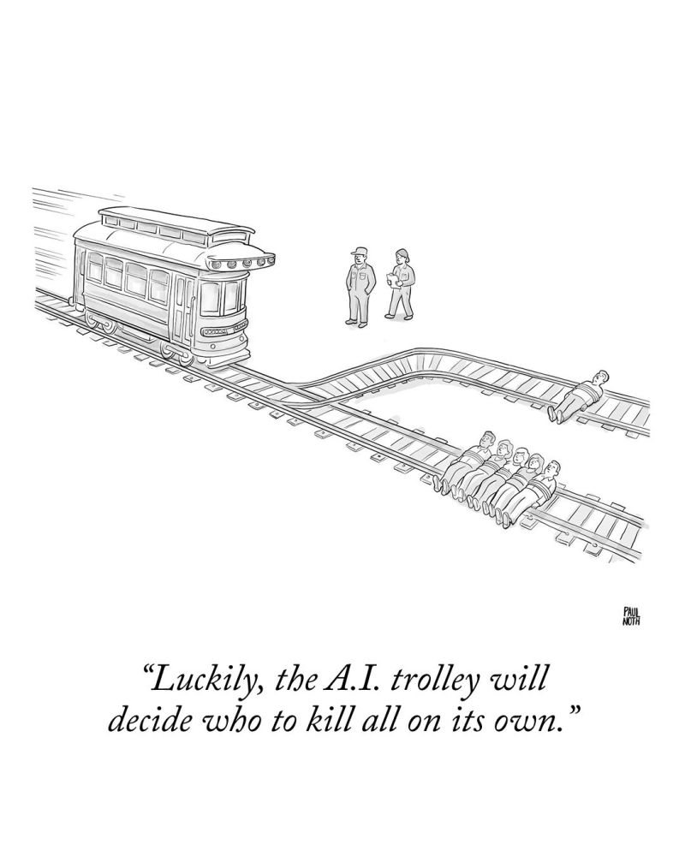
MISSING, THREE
Judgment
It cannot be stuck
with the consequence.
Notes:
And third, there's no judgment. It, it has no consequence. We can't put these things in jail. They don't care if we kill them. They're they don't care about the, the next generation or what the, what our children will inherit in this world. So as this New Yorker cartoon points out, it's folly- To give judgment to artificial intelligence.

Slide 29
CONSEQUENCES: WHAT RIDES ON BEING WRONG
Never take liberty, property
or life on a guess.
end a career · charge a suspect · settle litigation · start a war
And not business decisions either. Important decisions require deterministic work, and the burden of consequence.
Resting on someone who will carry that burden.
Notes:
And just putting a tighter point on that, we should never take liberty, property, or someone's life on a probabilistic guess. We need to show our work if we're going to end someone's career or charge someone with a crime, settle litigation, start a war or even make an important business decision. We should understand how we came to that calculation, and probabilistic models cannot do that. So that's part one, how the machines work. I hope that was helpful in getting a better understanding of probabilistic, deterministic processing and how they work together.

Slide 30
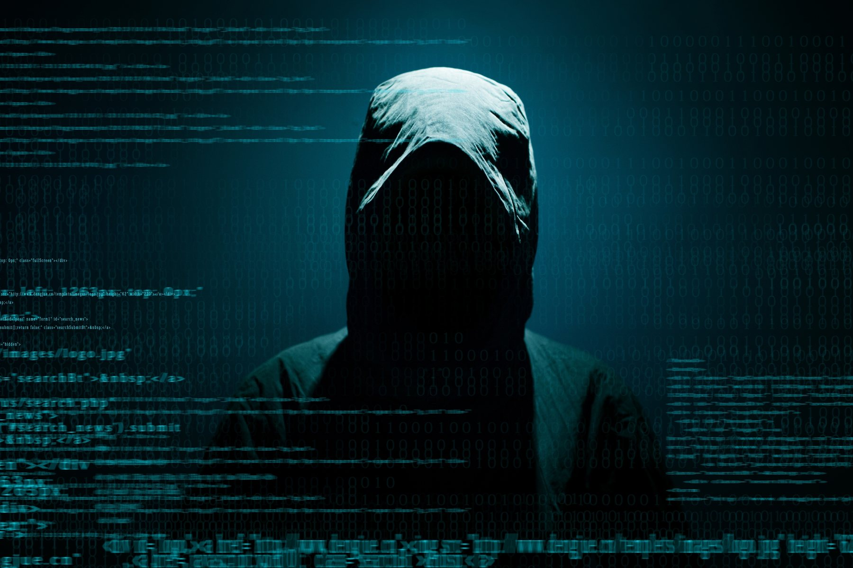
PART TWO
The black hat
Three impacts. No answers yet.
Notes:
So let's move into how the bad guys, how the criminals the hackers are using this against us.

Slide 31
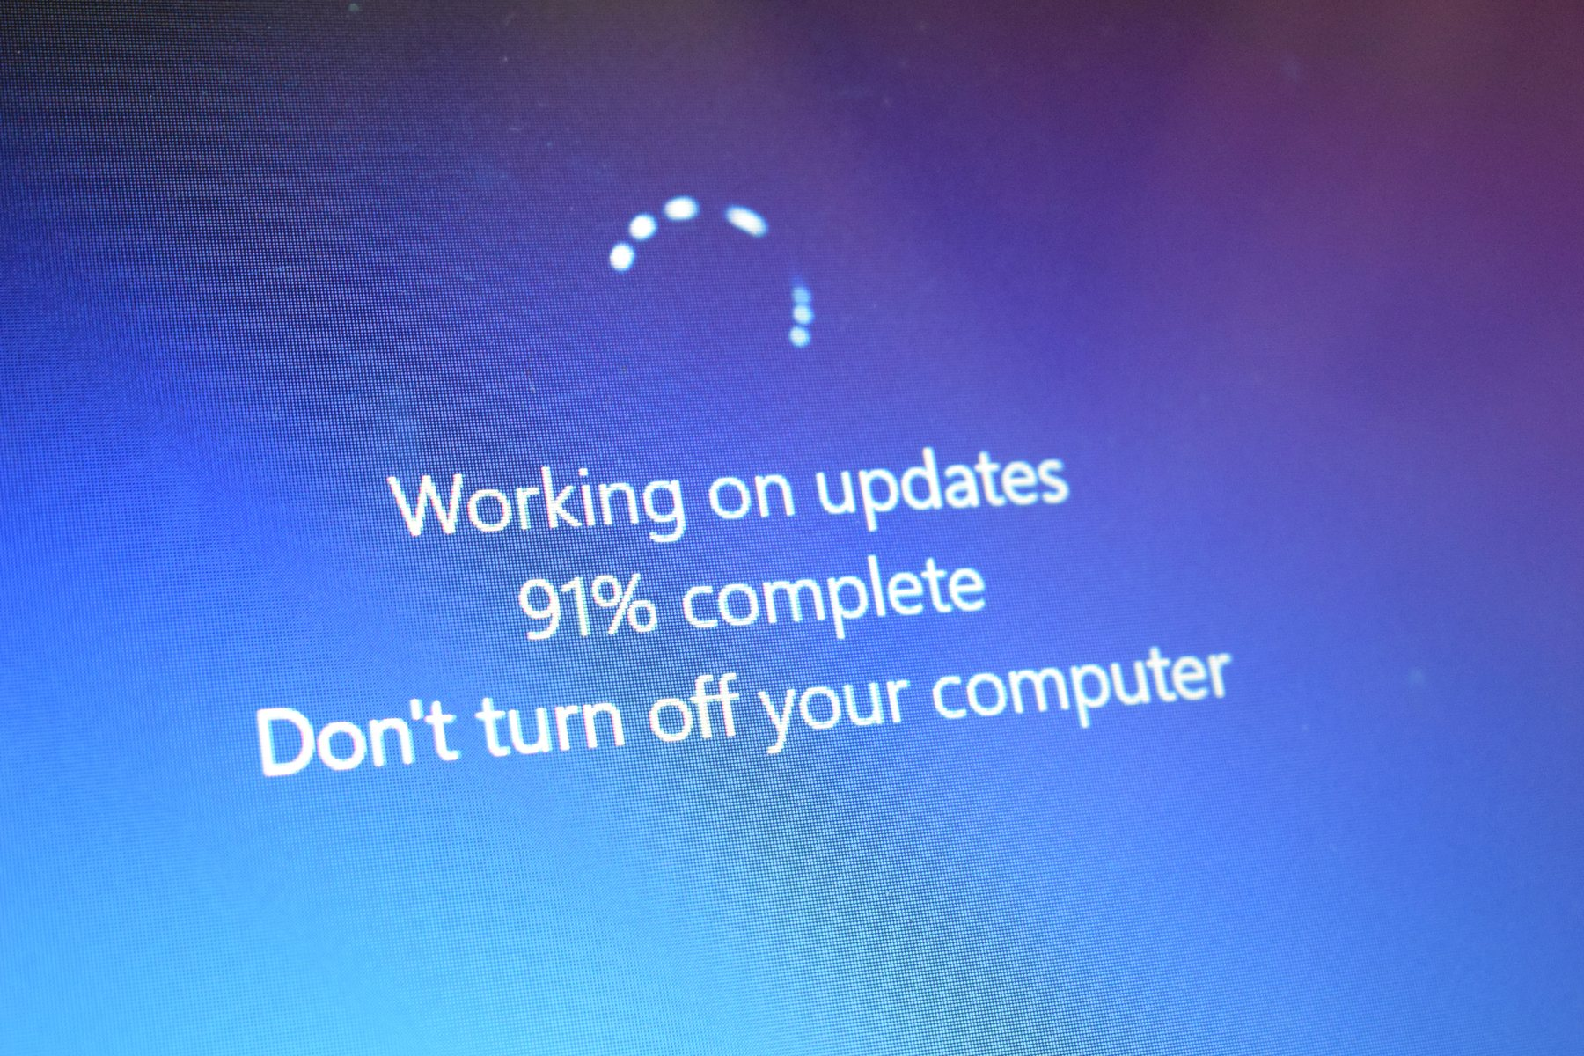
IMPACT ONE
Software
attacks
Zero-day: they know before the defenders do.
Notes:
The first thing is we've all been driven crazy by patches. You've probably all noticed that if you turn your TV on to watch a TV show, you have to update your TV and update your app, and these patches are relentless. We have long been in this battle of finding a vulnerability, getting a patch deployed before the bad guy can use that vulnerability to create an exploit. So that's been going on for years. The volume of it is just starting to ramp up, and we haven't seen this we haven't seen this fully realized yet, but it is a lot of vulnerabilities.

Slide 32
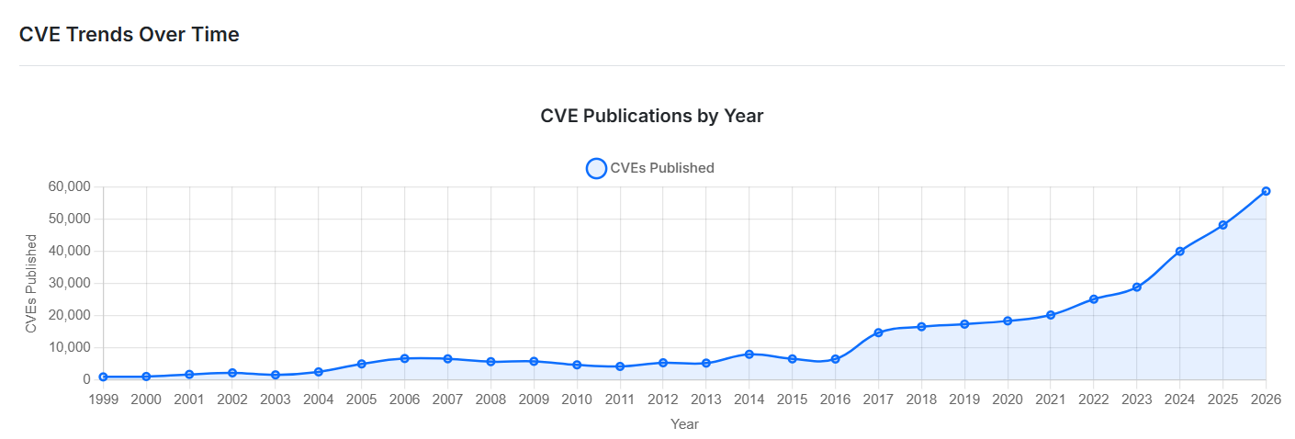
VULNERABILITIES AND PATCHES HAVE ALREADY EXPLODED
Every month we break a new record for finding them.
CVE publications by year
Notes:
Every month, we are breaking new records. So attackers can use generative AI probabilistic models to write exploits faster than they've ever been able to write them before. That's part one, impact one, software exploits are ramping up.

Slide 33
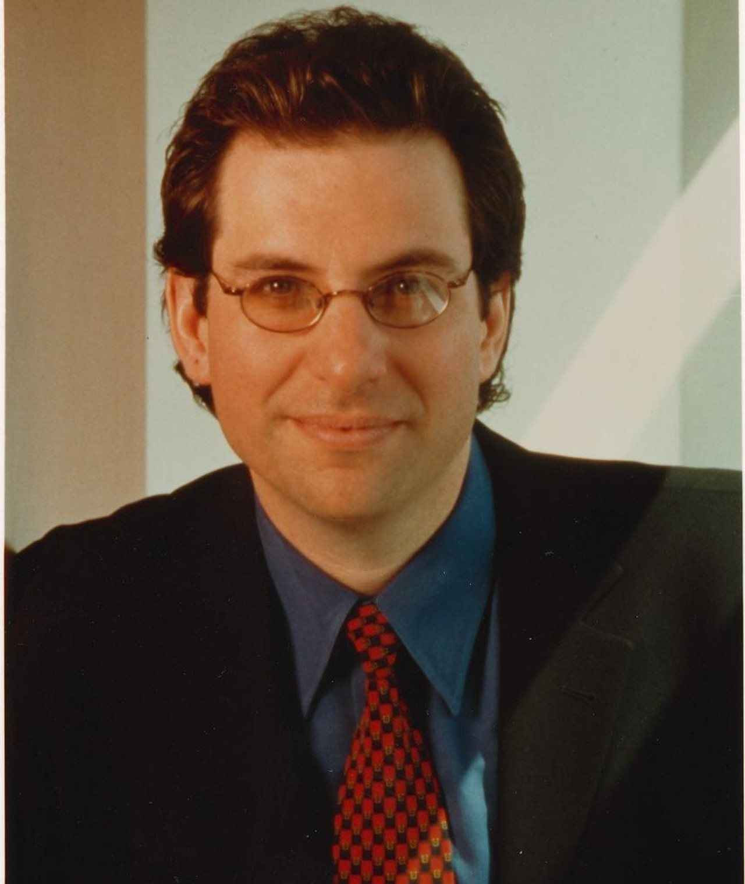
IMPACT TWO
Improved
human attacks
Kevin Mitnick got in with a clipboard and a confident manner.
Notes:
On the screen here is Kevin Mitnick. The time-outs coming up. He was the most famous hacker in the world, but he did not write software exploits. Instead, he would show up with a clipboard, look official, and talk people into sharing information, sharing passport-- passwords that they shouldn't, and get onto networks.

Slide 34
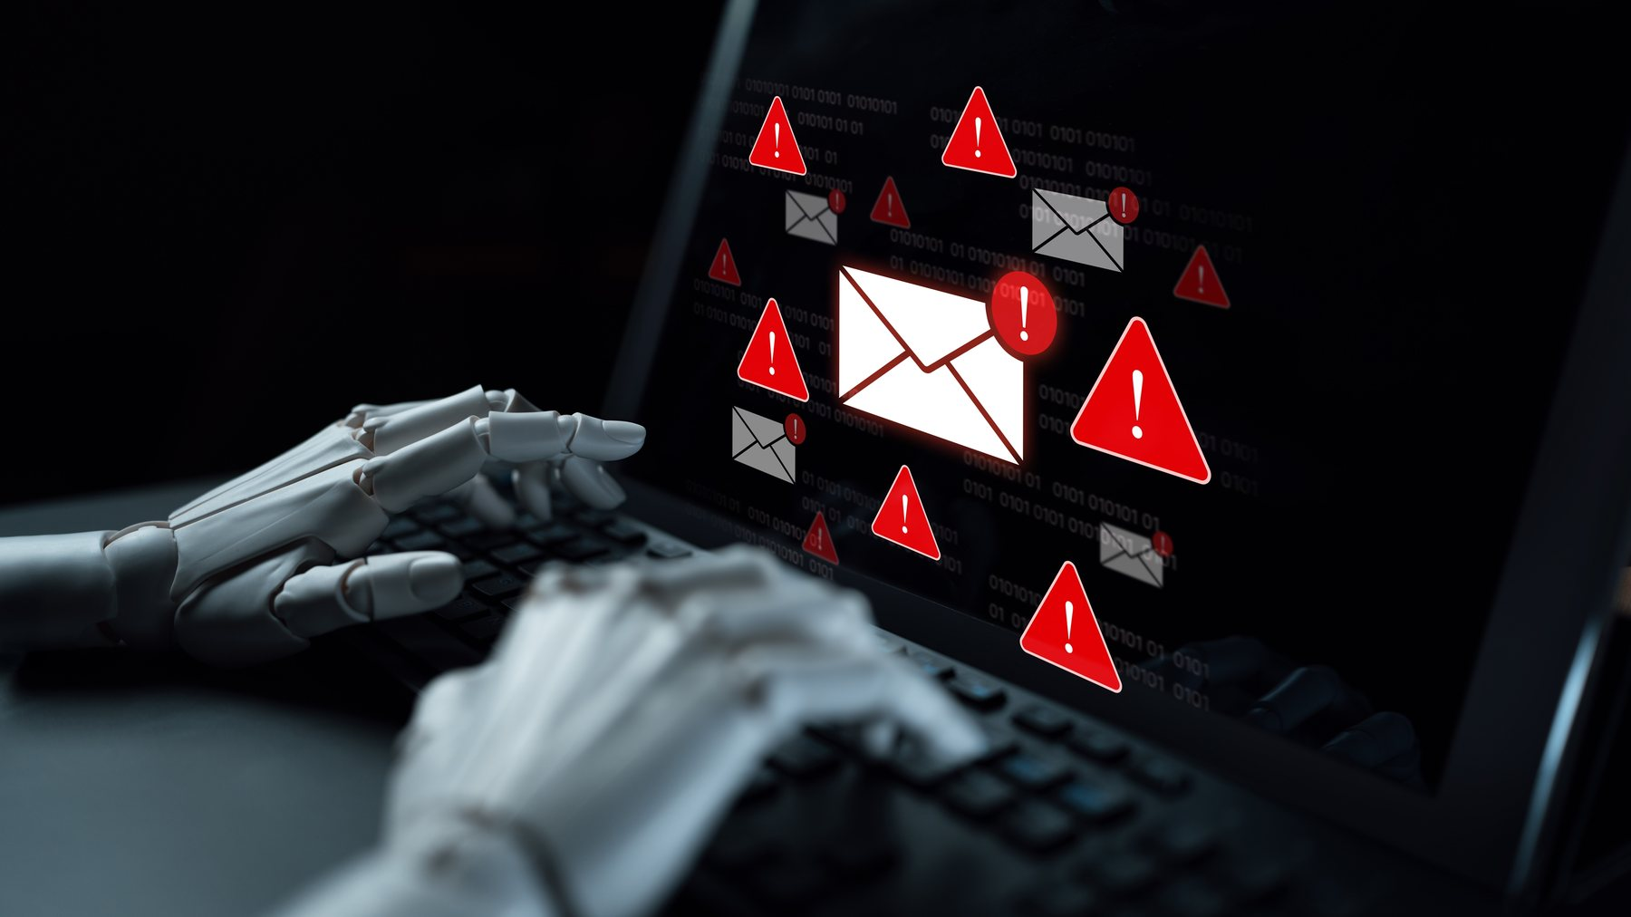
EMAILS, TEXTS AND SOCIAL MEDIA
The tells are gone.
No bad grammar.
No misspellings.
A landing page identical to the bank.
Written for you, by name.
Everything you were taught to look for is gone.
Notes:
For all of us that have taken security training and phishing prevention training one of the big impacts of generative AI is that all the telltale signs are should be missing. It's a very lazy attacker right now that's not running their phishing campaign through artificial intelligence to strip out bad grammar, strip out the misspellings generate a landing page that looks exactly like the bank or wherever the exploit's trying to take them. So we really need to pay attention. Ugh. We really need to pay attention to that. All the things we were looking for in the past are now gone.

Slide 35
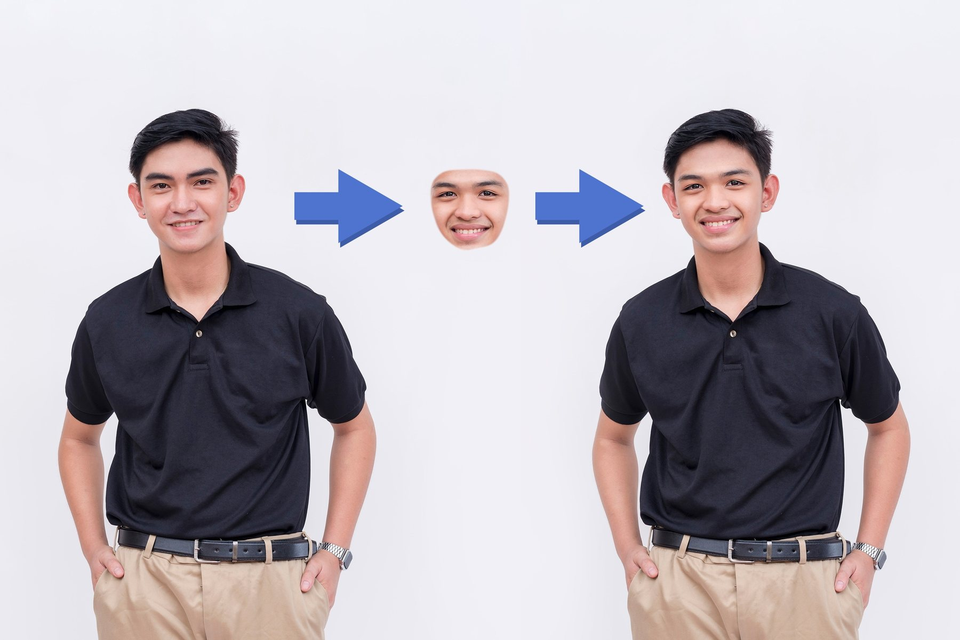
BEYOND THE INBOX
Your eyes and ears
have stopped
being evidence.
faces · voices · documents · mortgage statements · bank statements
Easy now. And cheap.
Notes:
Also, we can counterfeit anything. I can swap my face with your child's face or your employee's face or your boss's face and also swap my voice. I can generate f- fa- bank statements, passports, driver's license. Artificial intelligence has allowed us to forge virtually every piece of digital artifact.

Slide 36
FRAUD ONE
A voice you would know anywhere.
A few seconds of a birthday video is enough to clone it.
The call comes late at night, and they are crying.
There has been an accident. Money now. Don't tell Mum.
Urgency, shame and love, all working for the attacker.
Notes:
So an example of the first fraud, this one's for our parents. An attacker finds a recording of your child's voice online, clones it maybe from a social media post, clones it. Call goes in to grandmother, grandfather, "I'm in trouble. I need help. Please send money. Please don't tell mom." It sounds just like their grandchild, and the attacker is now working against the best instincts of a grandparent in extorting money from them.

Slide 37
FRAUD TWO
Pig butchering.
A wrong number. Then weeks of friendship.
An investment platform a trusted friend knows about.
A small withdrawal works. Then everything goes in.
One person ran a handful of these. A model runs thousands, all fluent, all patient.
Notes:
Second one has a horrible name. It's called pig butchering, and it's really taken off, and it's attacked both men and women across the United States and across the world starting with a few accounts here in New Zealand as well. But essentially, you bump into someone online. It starts a relationship. They either might be a wrong number, might be a, a DM that comes in the wrong way, some type of cute confusion that leads to a relationship, and sometimes it's romantic. And that relationship then goes on for weeks and months, and the, the relationship deepens. And in that conversation, an opportunity for an investment pops up a portal that looks great and official about that investment's there. A small transaction occurs, a return on the investment occurs, and this goes on and on until all of the assets are extracted from the target.

Slide 38
FRAUD THREE
A payment instruction from the boss.
An email, a text, or a voice note.
New supplier bank details. A wire before close of business.
The voice was cloned from a webinar.
Nothing technical about it. Hierarchy, urgency, and the reluctance to question the boss.
Notes:
Third one's for our finance offices. A voice memo, an email, a phone call, a text message posing as the boss comes in saying there's a new supplier with new bank details. We need to w- send this wire before the end of business. Stole the voice from a webinar like this one. We don't want to anger the boss. It's-- there's a sense of urgency. Seems to make sense. We send the wire without checking.

Slide 39
FRAUD FOUR
A bad hire.
Online, remote interview.
Forged references and online presence.
A state-sponsored or organized crime hire with access to internal systems.
A new digital Trojan Horse bringing an enemy into the team.
Notes:
One that's becoming much more of a problem, particularly for folks in critical infrastructure, is North Korea and cr- organised crime are posing as applicant, job applicants, and this has become very easy on remote hires. They're swapping their face if they need to. They've forged background credentials, references, and we're hiring them right into our networks as bad a- as bad actors with verified credentials that we've given them.

Slide 40
IMPACT THREE: AGENTIC AI
Prompt injection
Agent hijack
The attacker talks to your agent and confuses it into doing something it shouldn't. They inherit everything the agent can reach.
The attacker takes the user's machine, then drives the agent as the user. Every permission you granted, granted to them.
We gave agents the access we used to reserve for people.
Notes:
So first thing first impact, more exploits coming out against software. Second im- impact the human can be manipulated more aggressively. The third impact is agentic AI, that we are standing up AI and giving it permissions to everything. And so there are different attack patterns. A prompt injection is confusing the artificial intelligence. We give it a, a chatbot, maybe it's a sup-- help desk support chatbot or something that the attacker can access externally. Or it may be that they gain access using a backdoor to my computer and access my agent that's running on my machine.

Slide 41
WHAT WE ARE ALREADY HANDING THEM
Look at what we have given the agents.
Our email
Our protected files
Our trade secrets
Our source code
Our IT systems
Our HR systems
Our billing systems
Now a hacker takes the agent. Seven break-ins become one, at machine speed, with our permission on every action.
Notes:
But we've given these systems access to way too much. We've given them access to our email, our protected files, our trade secrets, our HR, our billing systems. And so if the criminal is able to gain access to our agent, they now have access to everything the agent has access to.

Slide 42
THREE IMPACTS
1
2
3
Software attacks
Human attacks
Agentic AI
Faster. Far more of them. Boring, and relentless.
Forged faces, voices and documents. The tells are gone.
The agents we invited in, carrying every permission we gave them.
Now, what we do about all three.
Notes:
So really three big impacts we're looking at with attackers. Much many... Faster, more relentless exploits coming out against vulnerabilities that can be detected with generative AI, and the exploit can be written with generative AI. So many ways to forge things that our eyes see and our ears hear using generative AI that allow us to be manipulated as human beings. And third is this net new way of manipulating our agents, our AI that we've brought into these into the surface area.

Slide 43

PART THREE
What we do
Built by people, on purpose, and it still holds.
Notes:
So this brings us to our third section. What do we do about all of this? How do we use these new tools? How do we combat them?

Slide 44
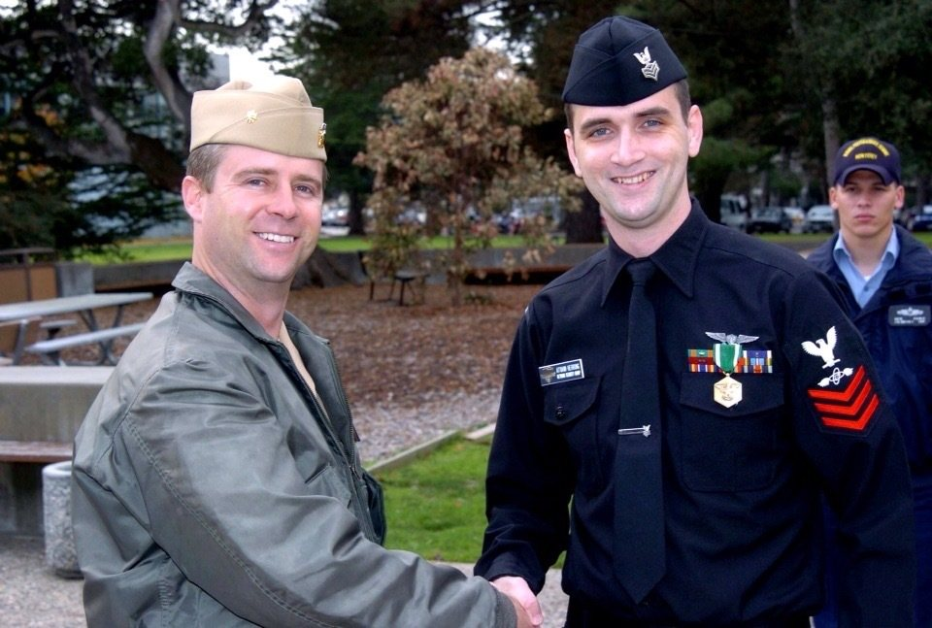
Break the chain
in one place.
A firewall would have stopped it
Endpoint protection would have stopped it
Patch management is what we used
Naval Postgraduate School, 2003. 5,000 devices, public IP space, no patching, no endpoint protection.
The attacker had to succeed across all of them. Blaster 2003. Sasser 2004. Defence in depth.
Notes:
So a, a short story. Back in 2003, I was a network security officer. Believe it or not that pic-- that young man on the right is a version of me, a much younger version of me. And I didn't have firewalls at that time. It was common in, in, in the early two thousands not to have firewalls, but I had no firewalls around my machines. There was no protection between them and the internet. I had no good endpoint protection on the five thousand machines on the network, and we did not have a, a patch management program. So in 2003 a teenager wrote a worm called MS Blaster, and it devastated the network. We were restoring backups for weeks. Everybody was all hands on deck restoring backups. And about nine months later a vulnerability was published and an exploit proof of concept was published for what would be Sasser. And so I had three choices, ei- three ways of preventing Sasser from devastating our network again. Either we had to get a firewall up, which didn't seem like that was going to be possible with... At the speed IT was moving. We need to get endpoint protection deployed to everything, which could not get that through procurement in time, and everybody was bringing their own device, and you had all the different areas different schools running their own things. We couldn't do that. So the only option I had was I needed to get this patch applied everywhere. So we used a number of innovations. You can read about it. I have a blog entry about the details of those innovations on the website. But we needed to do one of those three things. And so we did stop Sasser, which consequently was also written by another teenager at the time, or what we called script kiddies back in those days. So I just described three different controls: patch management, firewalls, endpoint protection.

Slide 45
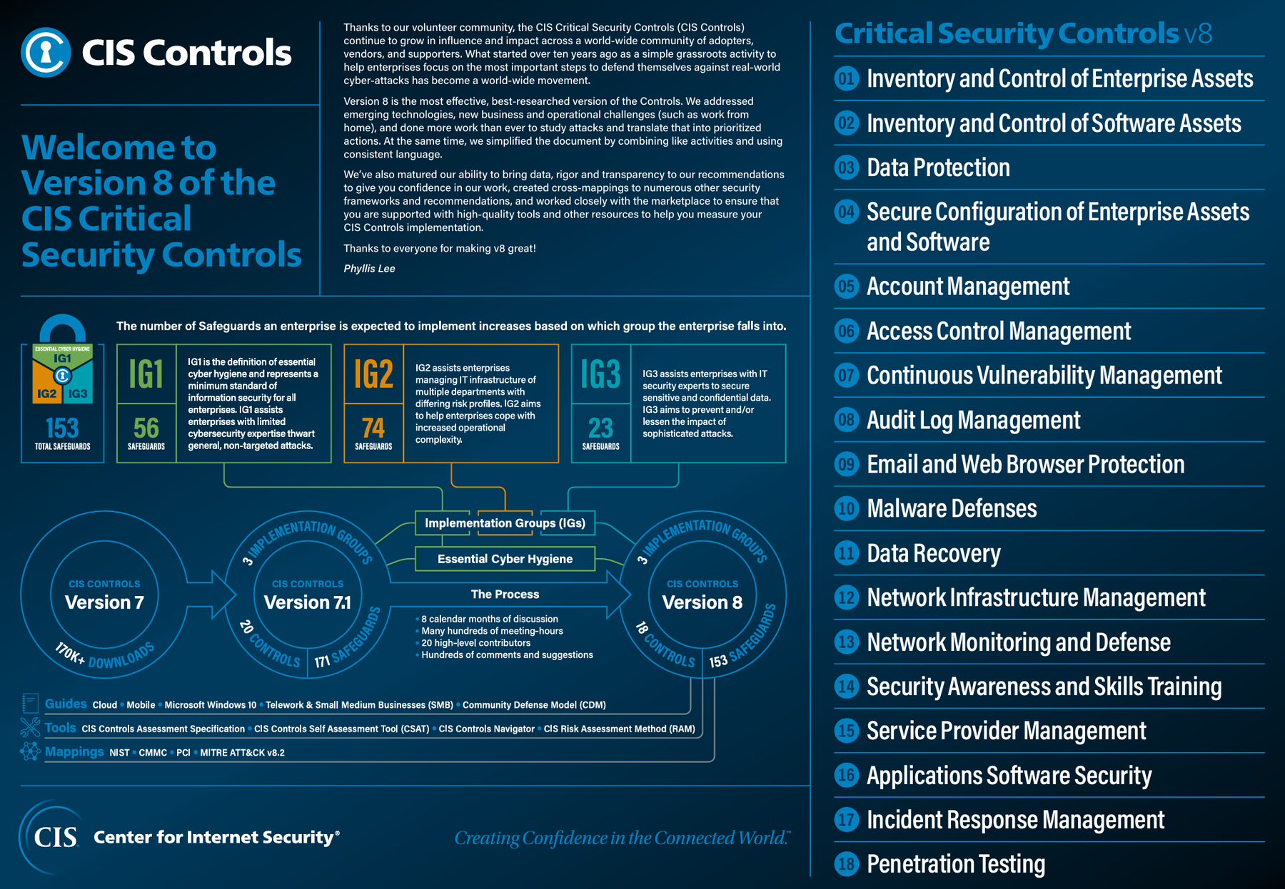
THE FRAMEWORK I RECOMMEND
18 controls.
Center for Internet Security
Critical Security Controls v8.
All three of my ways to stop Sasser are in here.
We will cover eight this afternoon.
Notes:
One link I'd encourage you to download today is going to the Center for Internet Security and downloading the critical security controls. There's eighteen of them. We're going to cover eight or nine of them here today. But they list out how do we harden our defences, and become sort of critical. Because we look at all of the data on all of these AI attacks, no program that's running a mature CIS level controls has been successfully attacked by any of these AI attacks.

Slide 46
There has not been a documented AI attack
that a mature programme running
CIS-level controls would not have thwarted.
The controls that stopped teenagers in 2003 still work.
Notes:
So the same stuff that would have worked for the teenagers back in 2003 and two thousand and four also work against these artificial intelligence. 'Cause remember, there's nothing intuitive. There's no ingenuity. They're not coming up with new attacks. They're just doing it more.

Slide 47
CONTROL ONE: PATCH MANAGEMENT
The gap used to be weeks.
Now it is hours.
Monthly
→
Weekly
→
Daily
The patch stand up. Every day, on infrastructure and code scanning both.
A cultural change, not a technical one. Deciding that patching outranks the roadmap this morning is the hard part.
Notes:
First thing you have to do is patch. We need to get very serious about pushing patches. We need to inventory where we're missing where we have vulnerabilities. We need to get those things pushed out. At WitFoo, every day we start work by looking at the list of unpatched vulnerabilities, and we fix those before we do the work we're supposed to do. It's just there's so many exploits coming out. It really needs to be a stop and think about how to accelerate this.

Slide 48

CONTROL TWO: THE FIREWALL
If they cannot touch the port,
they cannot exploit
the software behind it.
Deterministic. Cheap. Fast. It doesn't care how clever the exploit was.
Notes:
Second, unlike 2003, firewalls are on almost everything. We just need to make sure they're configured well and don't have big holes in them that'll let these attacks through.

Slide 49
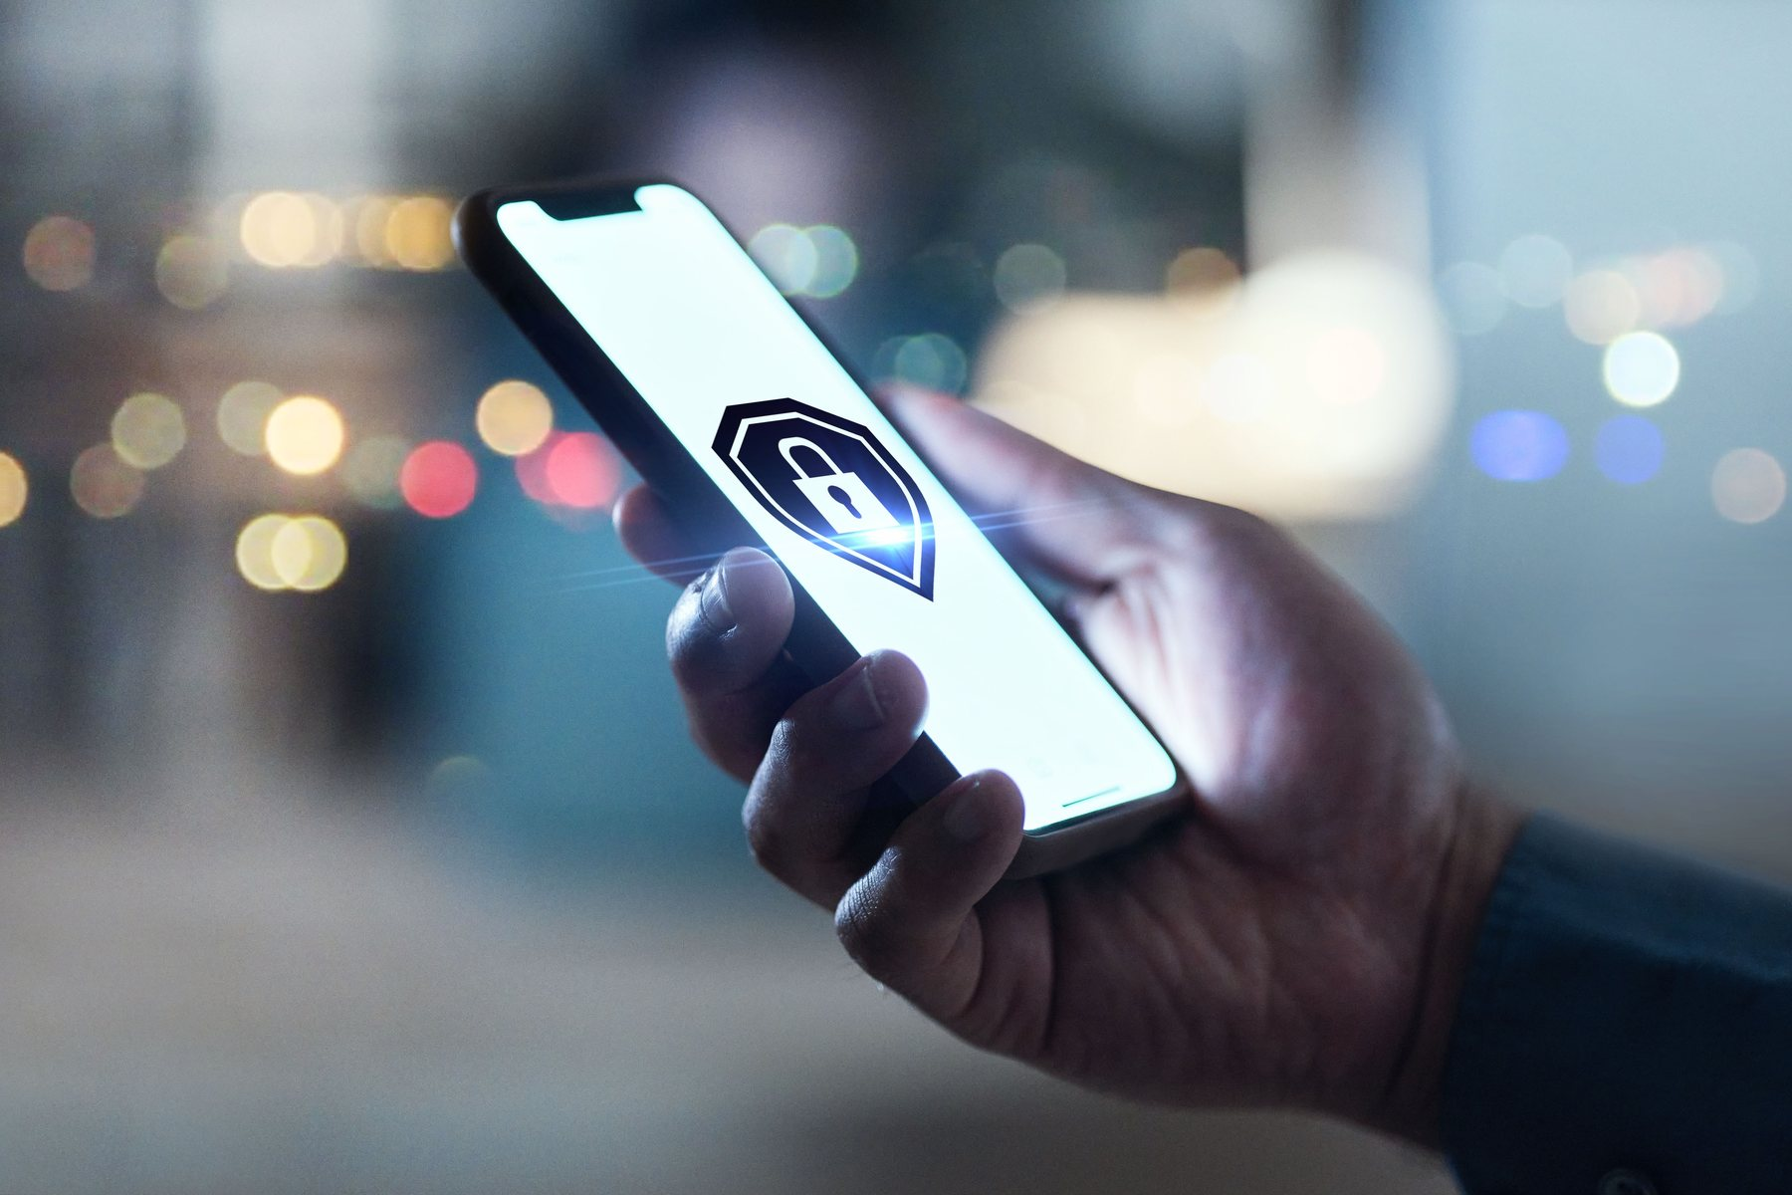
CONTROL THREE: ENDPOINT PROTECTION
Endpoint protection on
all of the machines.
All of them.
phones · tablets · laptops · anything that touches your data
Notes:
We need to get endpoint protection deployed to every computer, every laptop, every phone that has access to our systems, so that we're monitoring for bad behavior on those devices. We need to fix

Slide 50
CONTROL FOUR: MULTIFACTOR, PASSKEYS, PKI
Nothing to phish.
Nothing to guess.
Multifactor everywhere
Passkeys or PKI, not passwords
The private half never leaves your device
Passwords alone were a problem 25 years ago, when Mitnick was walking in and asking for them. They have aged badly.
Notes:
We need to get rid of passwords. So if you're still only using passwords, that's a huge problem because these AI attacks will guess your passwords. They will find copies of it on the internet. And so get off of password only. At least get multi-factor authentication deployed today to where you're using your phone or another device to verify authentication. That slows down attackers. But a better approach would be using public key infrastructure or pass keys that are using high cryptography to authenticate you. And so passwords have been a problem for twenty-five years, and they have not aged well.

Slide 51
CONTROL FIVE: ADVANCED EMAIL CONTROLS
Fight the machine
with the machine.
Use advanced email controls that run generative AI over inbound mail to catch phishing.
Phishing is a language problem, and language is what these models are actually for. This is the guesser doing the one job it is genuinely good at.
Notes:
Second is on our email. LLMs are good at finding are very good at finding these types of phishing attacks, and so we should be running we should-- this is one place where probabilistic processing is helpful. Does this look like a phishing email? So all of our emails run through that. Check with your s-control provider on what options are available for enabling more advanced phishing detection.

Slide 52
CONTROL SIX: HARDENED BROWSERS
The inbox delivers it.
The browser executes it.
Isolation
Block known-bad destinations
Stop the download before it runs
The email control and the browser control catch different halves of the same attack. Run both.
Notes:
Six, browsers. Harden the browsers. Look at the policies that we're using on our browsers and our phones and in our on our computers, and lock those down. Isolate execution and block bad destinations.

Slide 53
CONTROL SEVEN: THE LAST LINE
When did you last
test the backups?
Ransomware stops being devastating when every system and every byte comes back quickly and cheaply.
We don't check it until we need it. Check it.
Notes:
Backups. No, every... This is-- If you're going to get hit by a ransomware today, you better have a good backup. Backups save so much of our stress. It gives us so much more optionality. Had I not had backups to restore during Blaster in 2003, we would have lost years of research a-at the postgraduate, Naval Postgraduate School. Make sure you have good backups, and those backups are protected against attacks against the network. If you do, you're not going to need to pay out the ransom. But I find many or- organisations fail to set up good disaster recovery programs.

Slide 54
FOR THE PEOPLE WHO MAKE SOFTWARE
What actually finds
the vulnerabilities.
Static code analysis
Dynamic analysis
Application pen testing
Code fuzzing
Deterministic. Fast. Cheap. In our experience they catch almost everything.
Language models scanning for vulnerabilities are a helpful new layer. A layer, not the foundation.
Notes:
If you have your own software, you need to patch it. You need to get serious about it. You need to run static code analysis, dynamic code analysis, application pu- pen testing, code fuzzing. You also can run these generative AI models to do another scan. It's an expensive approach, but it does have the benefit of helping you write patches. You need to get serious about getting vulnerabilities out of your code.

Slide 55
CONTROL EIGHT: IT GOVERNS ALL THE OTHERS
Deny all. Then permit.
All controls are only as good as they are configured. Open gaps in your layered defences using the smallest exceptions possible.
Every connection
Every authentication
Every user action
Every agent permission
New Zealand has great security experts. Kordia, Defend, SSS and others can help with the assessment and the plan to deploy the Controls.
Doors don't work if we don't lock them.
Notes:
Then the, the, the overarching thing is a no trust po- or zero trust policy. Block everything until you have a reason to poke the smallest possible hole into the security controls. So work with great partners here in New Zealand like Kordia, Defend or SSS to help you understand how to build a strategy of zero trust around critical security controls.

Slide 56
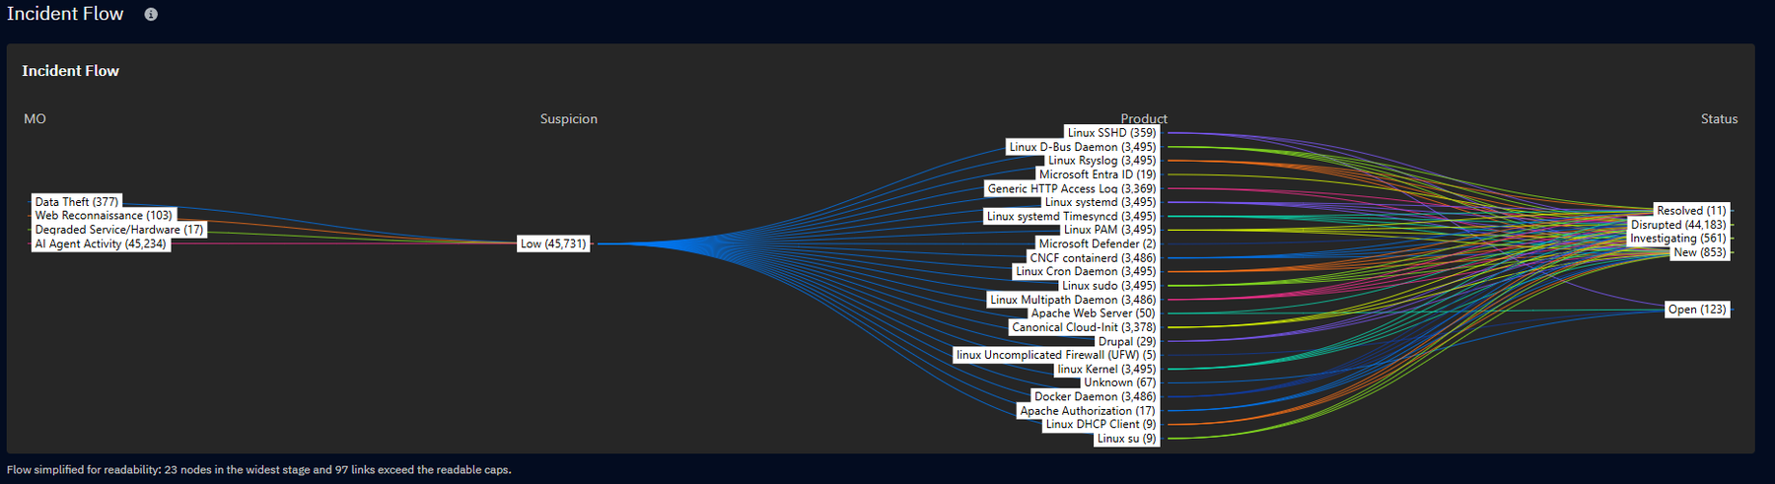
AI ATTACK SLOP: THE NEW SCRIPT KIDDIES
45,234 AI-driven attacks this month. All boring.
No new techniques. No sophistication. Just more.
WitFoo incident data, September 2026
Notes:
As we look at this is a chart of the attacks that happened I think I pulled this last week, of attacks coming in against WitFoo infrastructure, people that are trying to shut down our services, steal our data. There were more than forty-five thousand AI-driven attacks, so the volume of these attacks are massive. There's about, I think five hundred, less than five hundred non-AI attacks. So the, the volume of attacks have exploded in what we're seeing at WitFoo against our own infrastructure.

Slide 57

MORE WAVES
The rock
did not move.
A bigger wave than we
have ever seen, breaking
against controls we already
knew how to build.
Notes:
But because we have these controls in place and we've locked down the gaps, we're, we have an infrastructure that's like a rock. We've thought through all of these sloppy attacks. The waves come in, they crash harder, they crash faster, but they're boring. These, these boring attacks do not affect what we're doing.

Slide 58

FROM CONTROLS TO REPORTS
REPORTS FOR EVERYONE WHO HAS TO READ THEM
Auditors
Insurers
The board
Police
The controls
you just built
Partners
MSSP
Regulators
The team
How compliant, and how secure, things actually are. Each reader in their own language.
Notes:
So a little bit about the research I do at WitFoo. We take all the data in from the controls that we've just discussed. We ship it out to all of the people in your team that need to figure out do we have the controls in place? Are they working correctly? What type of attacks are we seeing? And coordinating that information inside of your organisation and outside.

Slide 59
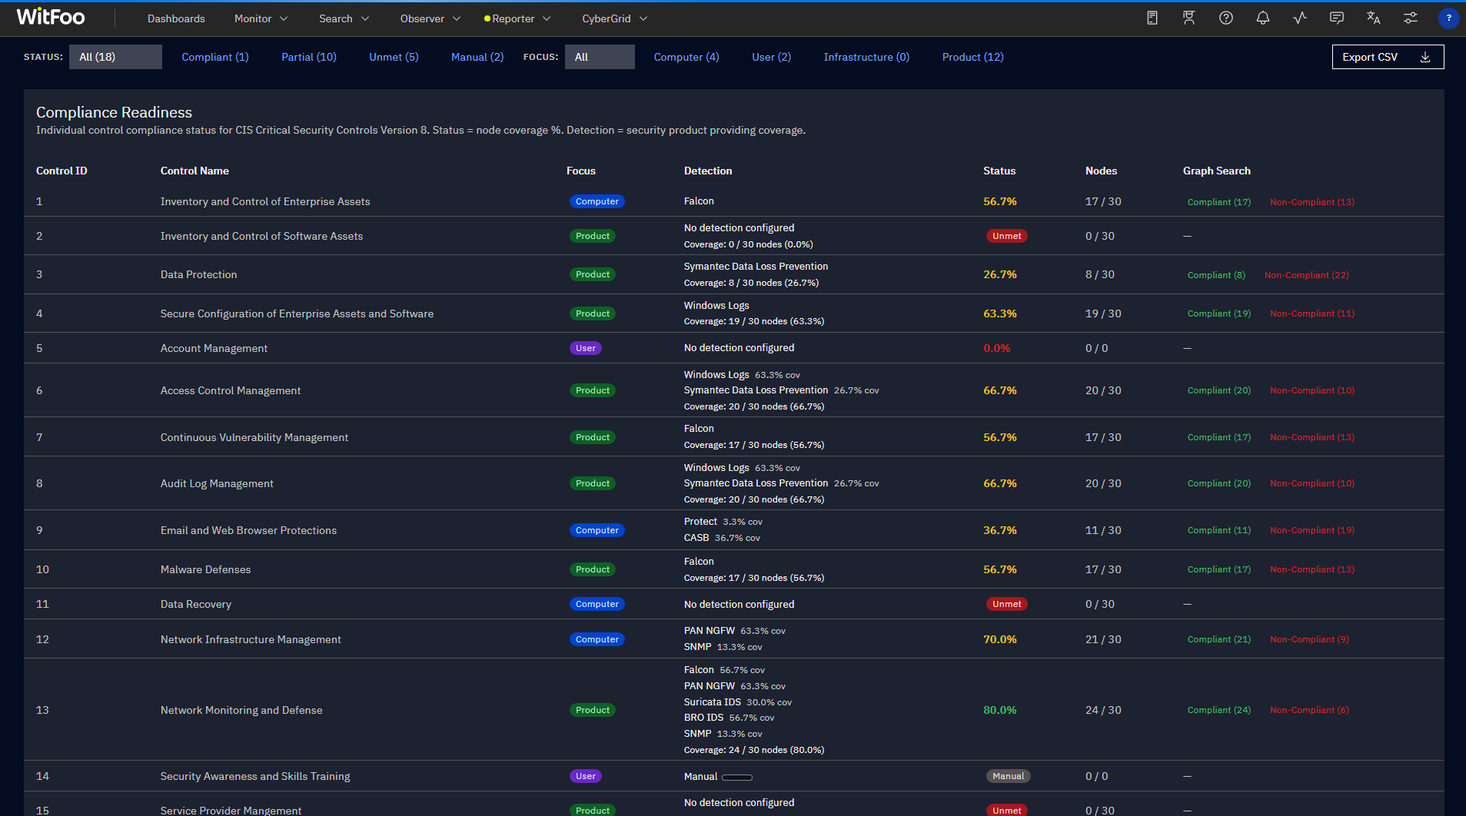
COMPLIANCE READINESS AGAINST THE CRITICAL SECURITY CONTROLS
Control by control: covered, partial, unmet. If this is of interest, reach out to me or a local WitFoo partner.
WitFoo Reporter, Compliance Readiness. Example organisation, thirty nodes.
Notes:
So this is an example of a deterministic inventory of the critical security controls and how ready, where we have gaps in each one of those controls. If you'd like to use this, please download it or reach out to one of the WitFoo, local WitFoo partners.

Slide 60
THE ADVANTAGE THEY DO NOT HAVE
Criminals cannot share.
We can.
They compete with each other
We defend the same community
No warnings. No shared tooling. Nothing published.
Tell each other at nine; the sector is harder to hit by lunchtime.
That is a superpower. Almost nobody uses it.
Notes:
One of the advantages we have, and pro- and it's very important that criminals do not have, is they are isolated working with these computers alone. We can work together. We can defend this community together better than we can do it alone.

Slide 61
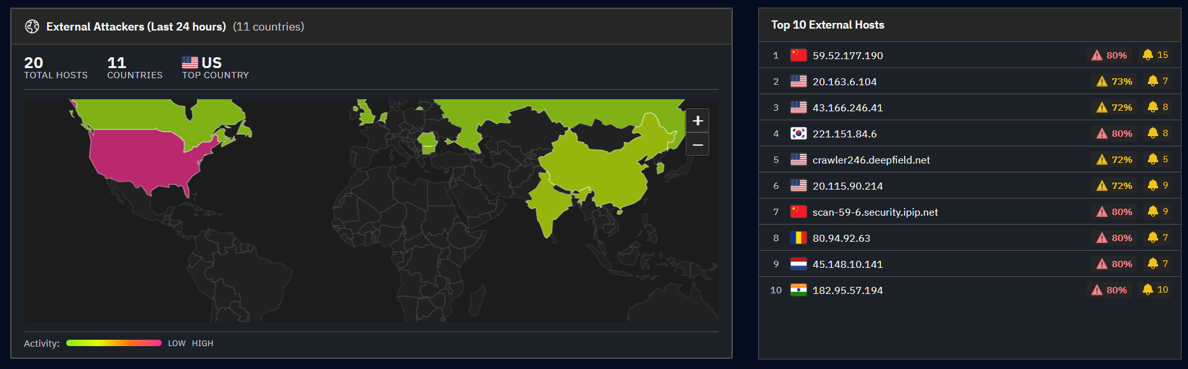
OUR CONTROLS CREATE THREAT INTELLIGENCE
Anonymous sharing can accelerate defence. We have and are ignoring key insights.
WitFoo Analytics, Security Overview. Example organisation.
Notes:
One of the things we have is all of us are generating billions of signals every day about where the attacks are coming from, and we can... We're not sharing these with each other. And so one of the things I work on is how can we securely and anonymously share this intelligence across New Zealand. And so whether you use WitFoo or use another product, be sure to share with your neighbour the attacks that are popping up. That's one of the core things about good neighbourhoods.

Slide 62
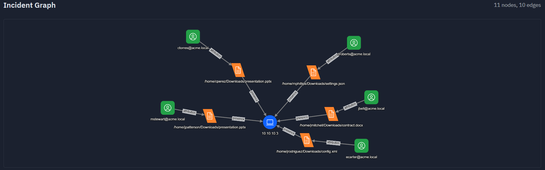
FORENSIC RECORDS FOR INVESTIGATIONS
Investigators need concrete evidence in investigations. Treating signal like evidence creates new deterrence.
WitFoo Analytics, Work Unit. Example Ransomware.
Notes:
Secondly is if you do have a security incident that needs to be investigated, you want to make sure you collect signals from all of these different controls as if they're evidence, and we're collecting it in a way that's going to make it easy for law enforcement, NCSC, and other partners to determine what happened, not only s-so that you can understand it and better protect against it, but so that we can, as a, as a community, better protect against it in the future.

Slide 63
SECOND TO HYGIENE: COLLECTIVE DEFENCE
Safe neighbourhoods are made of
neighbours who talk.
to each other · to their MPs · to their police
Report cybercrime in formats the NCSC and Police can actually use.
Notes:
So, you know, safe neighbourhoods digitally are the same as safe neighbourhoods in the real world. We talk to one another when we see things going on in the neighbourhood. We talk to our MPs, members of parliament. We talk to law enforcement. We listen to law enforcement and NCSC.

Slide 64
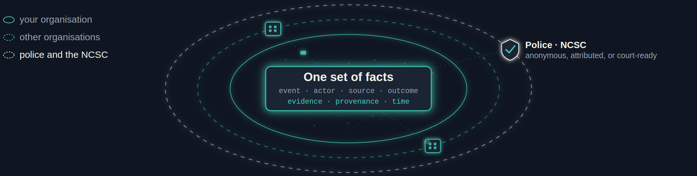
SHARING: OTHER ORGANISATIONS, AND THE POLICE
What one of us sees,
all of us can use.
Identity stripped on the way out. You choose what leaves — incident by incident, field by field.
FBI Hive infiltration, 2022: only one victim in five had ever reported. A crime nobody reports is a crime nobody prosecutes.
Notes:
And so this is another piece of research I work on, is securely sharing evidence, securely sharing intelligence between each other and between law enforcement to drive down costs.

Slide 65
COLLECTIVE DEFENCE IS THE DISCOUNT
Defending alone
~NZ$400K a year
In a ten-organisation sector grid
~NZ$75K a year
At 1,000 organisations: under NZ$20K. The saving is the incentive. The evidence is the point.
Costed in the University of Canterbury research: NZ healthcare worked example, fully-loaded standalone baseline
Notes:
And not only does it drive down cost in detection and response, when you work together in purchasing all of these controls that we need, you can go from spending four hundred thousand dollars a year doing it by yourself to where if you pull together ten people across your industry, your sector, or even here locally, if Canterbury was to put something together, you go from four hundred thousand dollars of spend a year down to seventy-five. And if you pull it out to a thousand, when we look at something like New Zealand Health you can go as low as twenty thousand dollars by buying these things as a group instead of going alone.

Slide 66



TAKEAWAY 1 OF THREE
1
Attackers can launch boring attacks
faster than they ever could.
Not cleverer. Faster, and many more of them.
So make sure your critical security controls are in place, and that somebody owns each one.
Use software like our own WitFoo Reporter to track the gaps, the risks and the compliance. And lean on cybersecurity partners to help build the strategy.
Notes:
So three takeaways from today. First, the attacker can launch a lot more attacks. They're boring, but they're volumetric. And so it's critical that we look at the critical security controls reach out to partners like SSS, Kordia, Defend, use software like WitFoo Reporter to inventory where you sit in a control, maintain a readiness so that the rock is a rock and not a bunch of pebbles floating in the water.

Slide 67
TAKEAWAY 2 OF THREE
2
Criminals can forge digital video,
email and documents.
So spend more care on in-person and time-tested verification.
A number/URL you already had
A passphrase
Walk down the corridor
never the one in the message
with the people who matter, at work and at home
face to face beats a face on a screen
Those checks are not old-fashioned. They are the ones that still work.
Notes:
Second, criminals can forge everything, so the best thing that we can do is not stay at our computer. We need to get up and walk over and talk to the person. We need to have passphrases that we share with our loved ones to validate who we are. And if we have a, a number or an email a number or a URL in an email, use the one you know, not the one that the fraudster gave you.

Slide 68
TAKEAWAY 3 OF THREE
3
Use our human superpowers.
Judgment
Community
Collaboration
they cannot answer for anything
they cannot want anything
they cannot invent anything
Reach out to your sector and your community. Build collective defence, and drive down the risk and the cost at the same time.
charlesherring.com #TechSummit26
Notes:
And then lastly, let's use our human superpowers. Our ability, judgment, and intuition, and ingenuity, our ability to collaborate and work together is much greater than the ability to generate these derivatives at speed out of artificial intelligence. Reach out to other people in your industry, reach out to NCSC and to the New Zealand Police and find ways and I'm happy to be a help in that as well, on how do we come together and work as a community to deal with cybercrime at speed.

Slide 69
Questions?
Counting
Imagining
LCDR Data
The black hat
Blaster & Sasser
The rock
charlesherring.com · #TechSummit26
Notes:
So again, this deck all the things I referenced here today are up on charlesherring.com. I encourage you to download it, and I'm happy to answer any questions in the time that we have remaining.

